Slide 1
Facts & Figures
November 2025

Slide 2
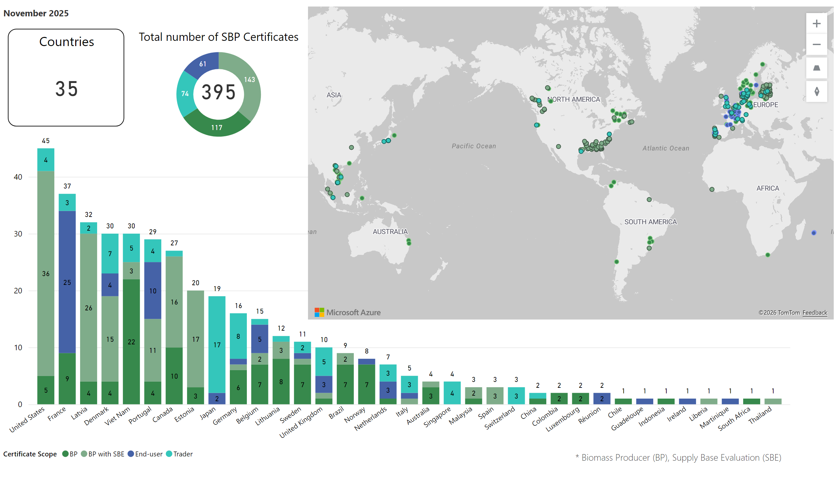

All CHs
Notes:
map
No alt text provided.
Certificates by Country
No alt text provided.
Total number of SBP Certificates
No alt text provided.
Countries
No alt text provided.
donutChart
No alt text provided.
textbox
No alt text provided.

Slide 3
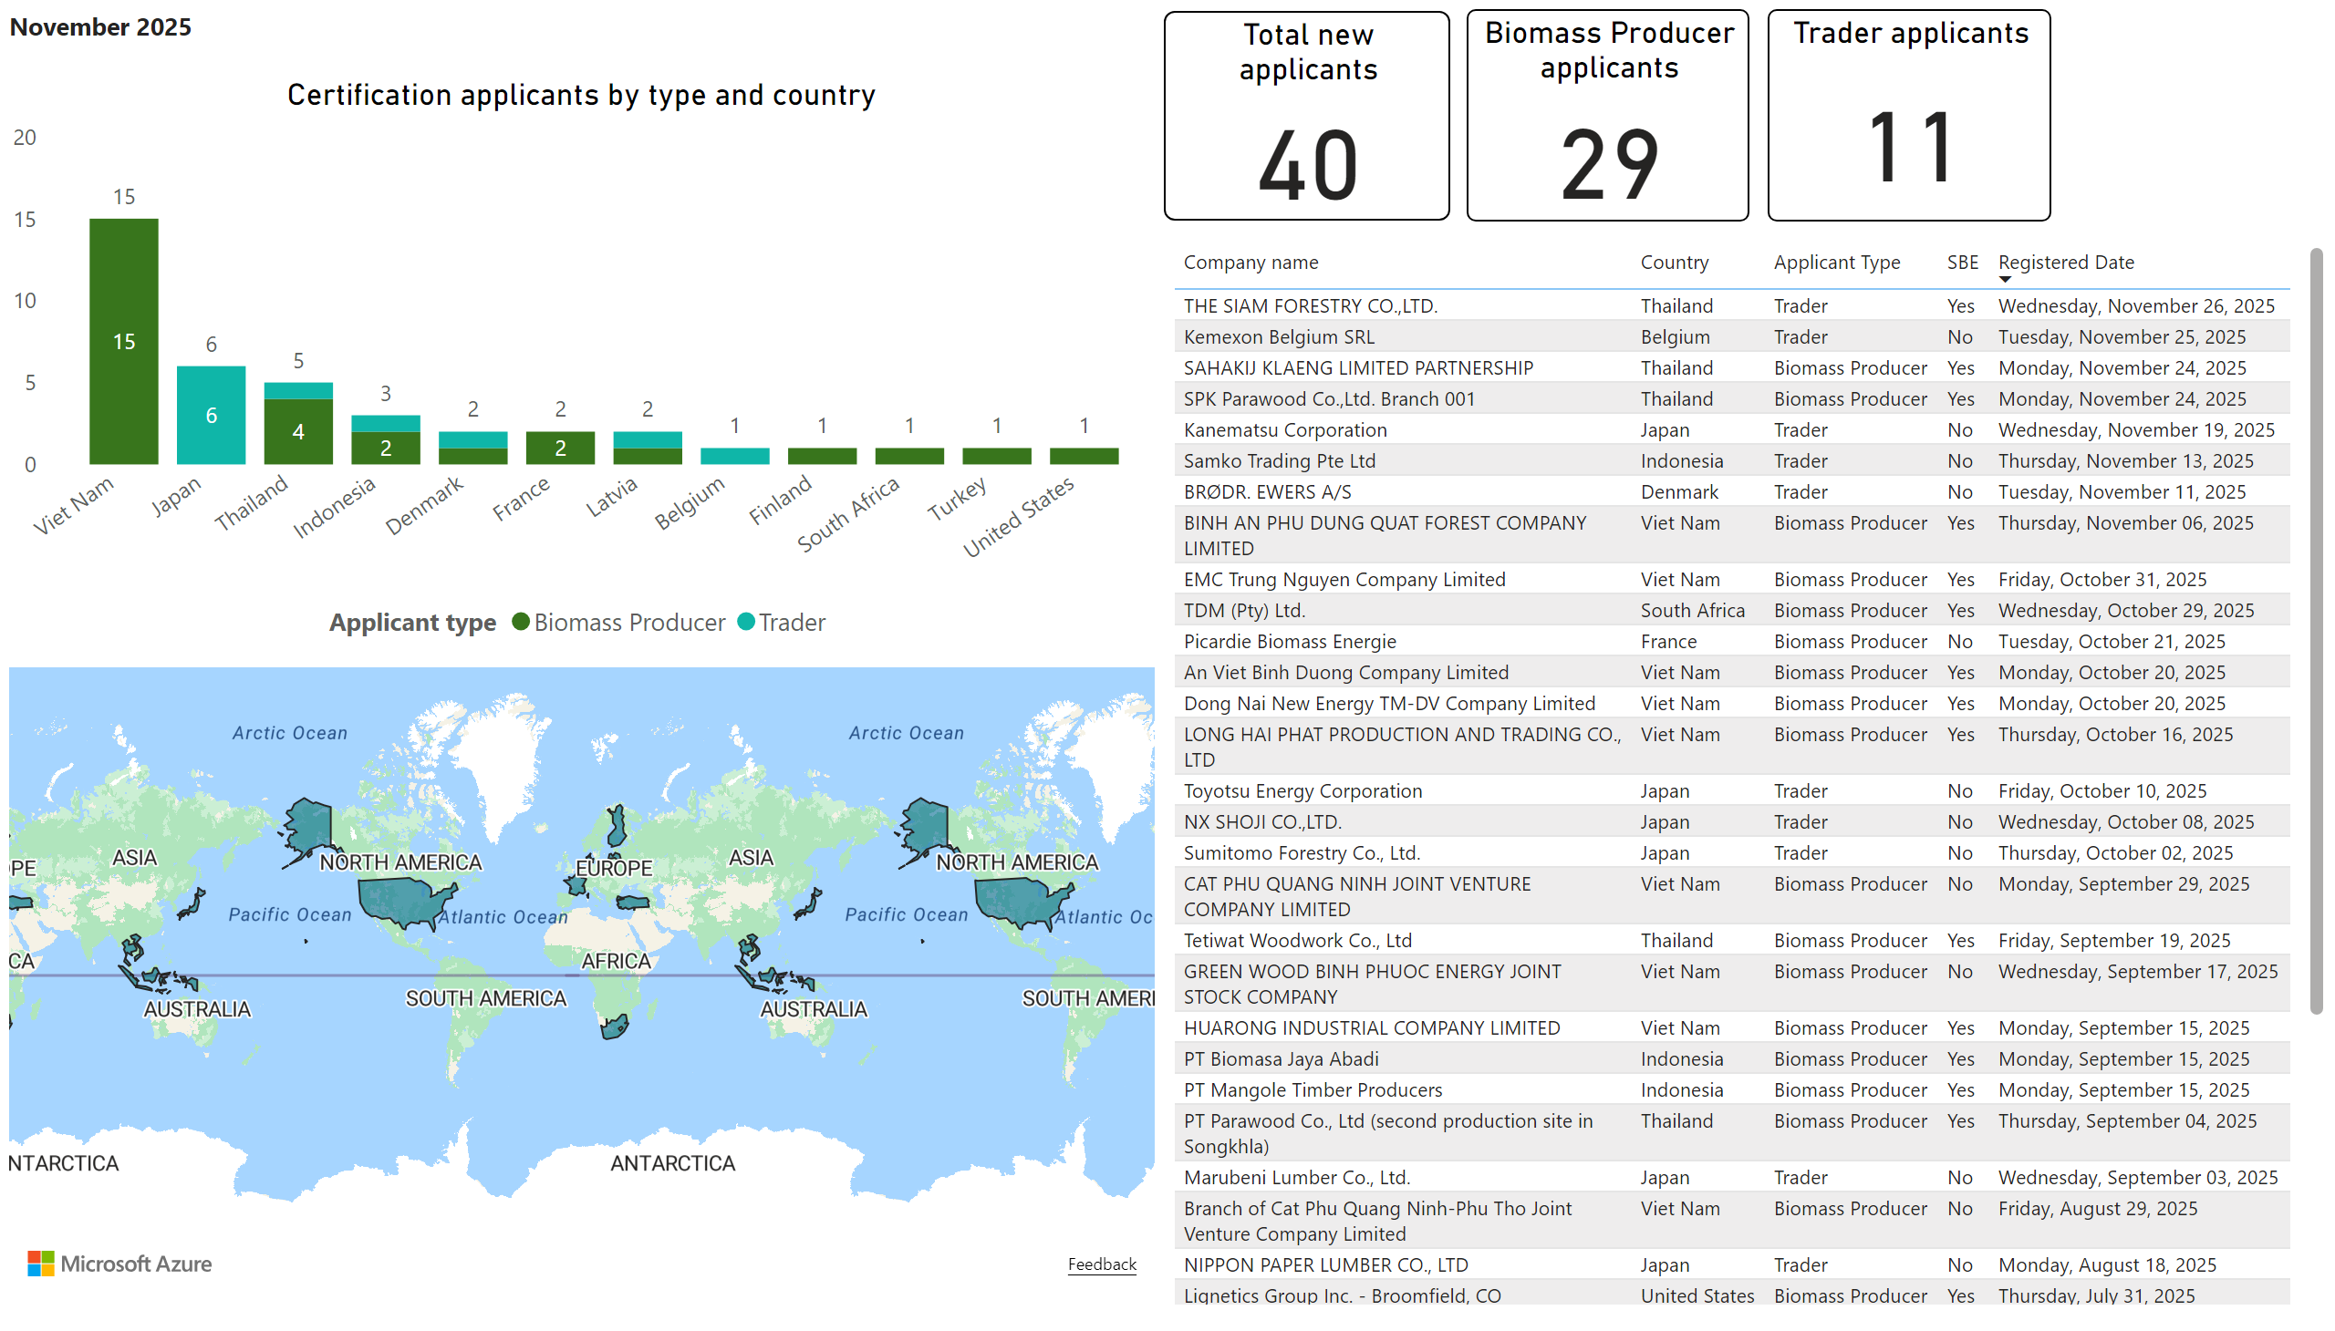
SBP Applicants
Notes:
Certification applicants by type and country
No alt text provided.
Total new applicants
No alt text provided.
filledMap
No alt text provided.
tableEx
No alt text provided.
Biomass Producer applicants
No alt text provided.
Trader applicants
No alt text provided.
textbox
No alt text provided.

Slide 4
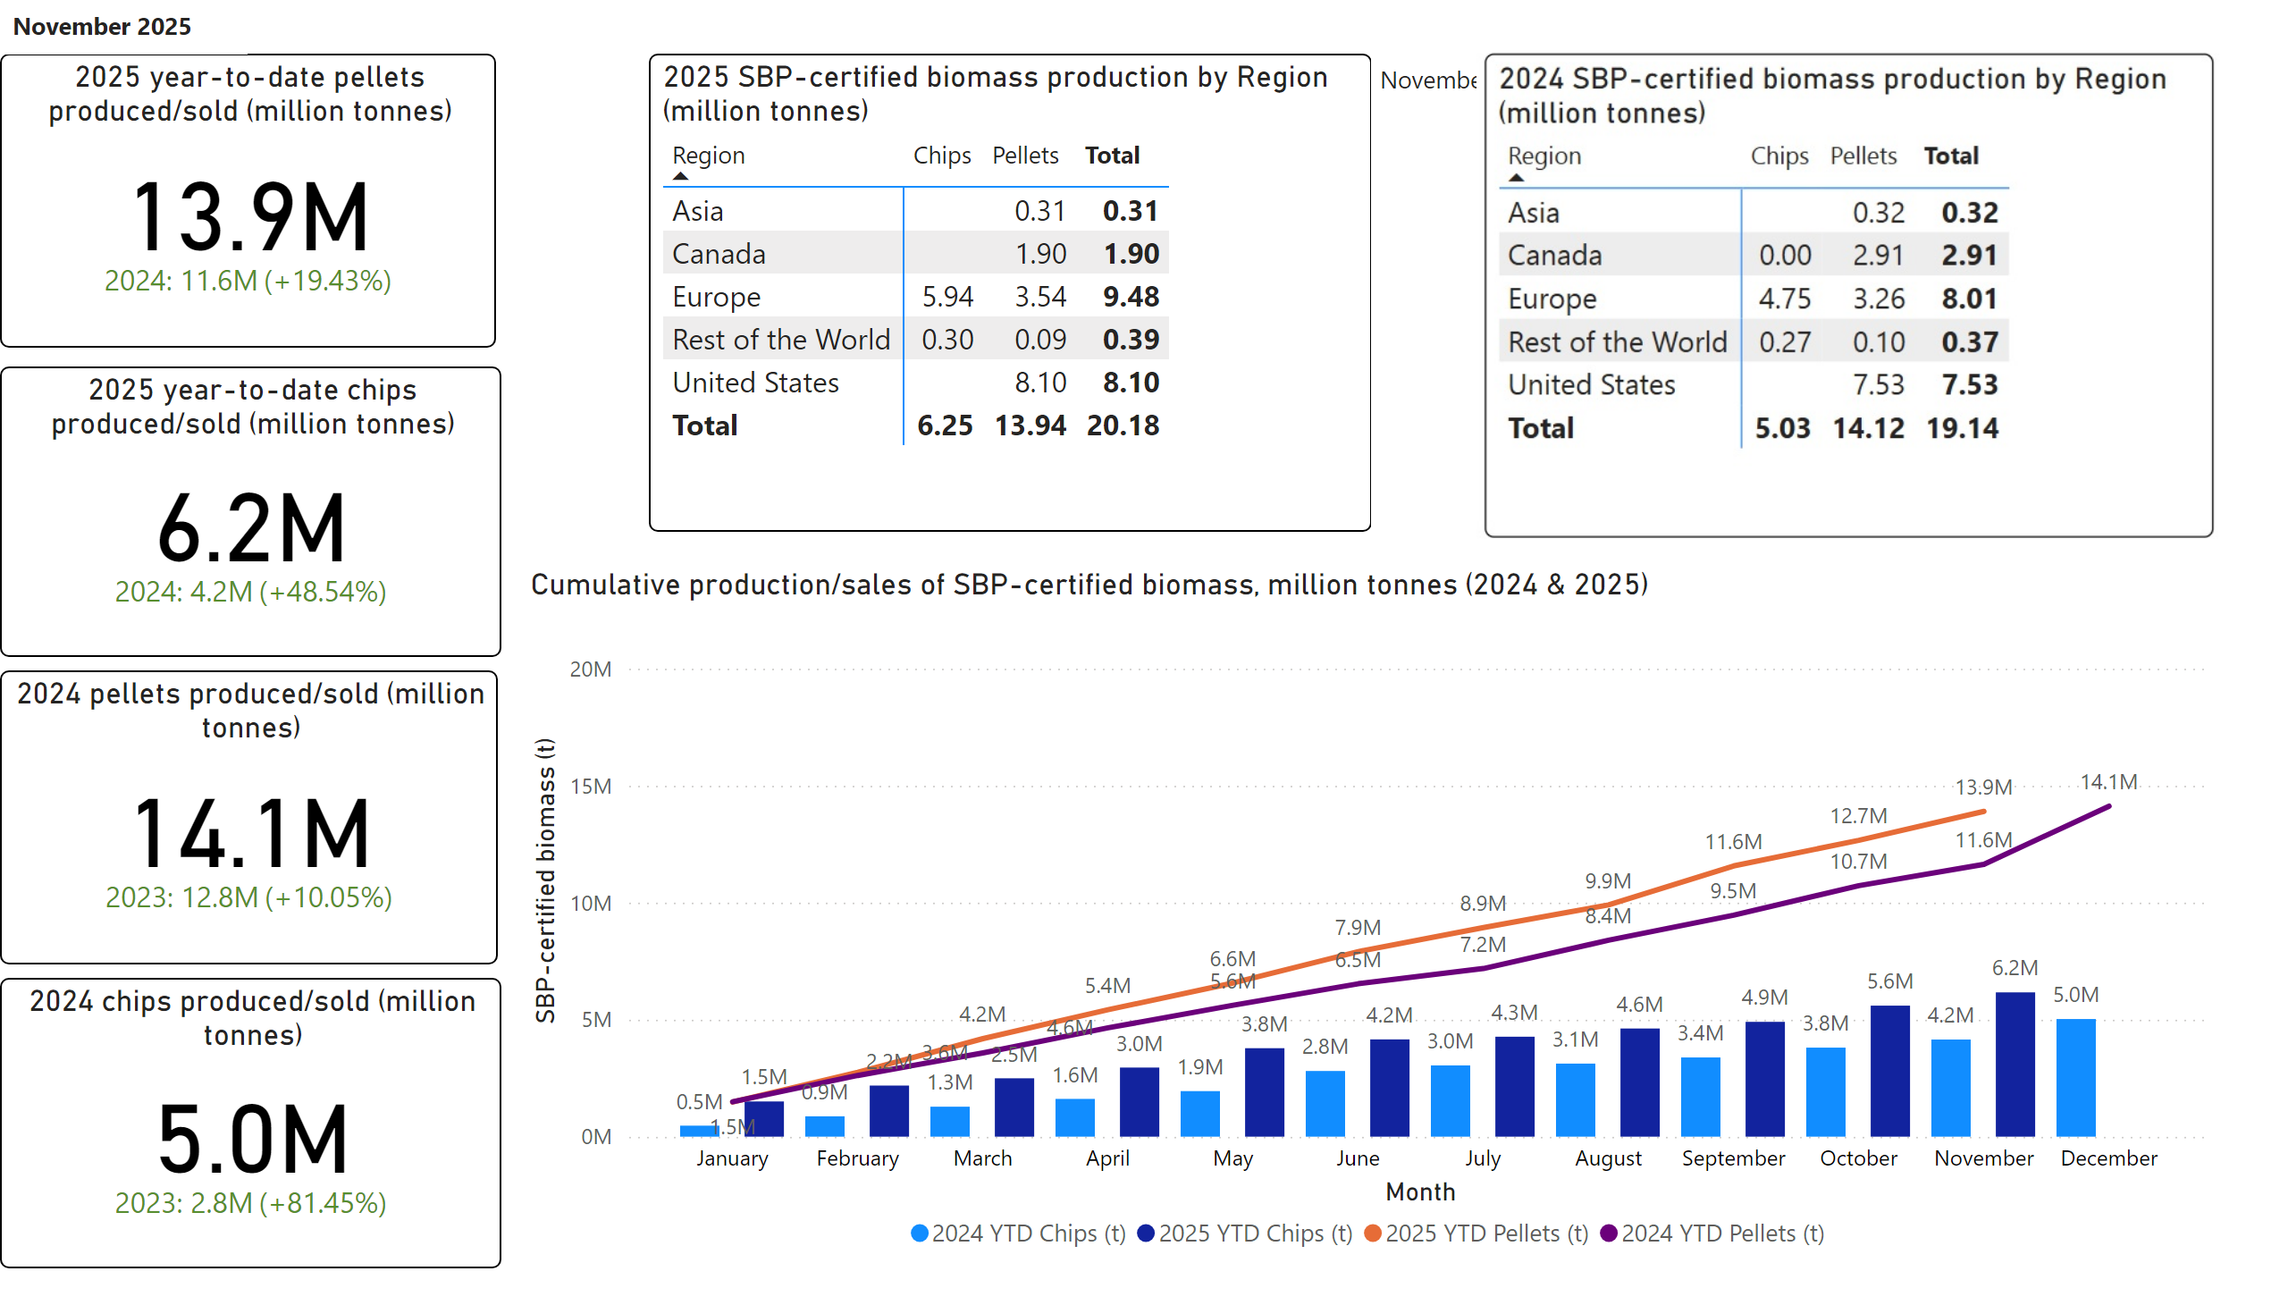
SBP Biomass
Notes:
2020 chips produced/sold (million tonnes)
No alt text provided.
Cumulative production/sales of SBP-certified biomass, million tonnes (2019 & 2020)
No alt text provided.
2020 SBP pellets produced/sold (million tonnes)
No alt text provided.
2020 SBP-certified biomass production by Region (million tonnes)
No alt text provided.
2021 year-to-date chips produced/sold (thousand tonnes)
No alt text provided.
2021 year-to-date pellets produced/sold (million tonnes)
No alt text provided.
2021 SBP-certified biomass production by Region (million tonnes)
No alt text provided.
textbox
No alt text provided.

